Slide 1
PART -II

Slide 2
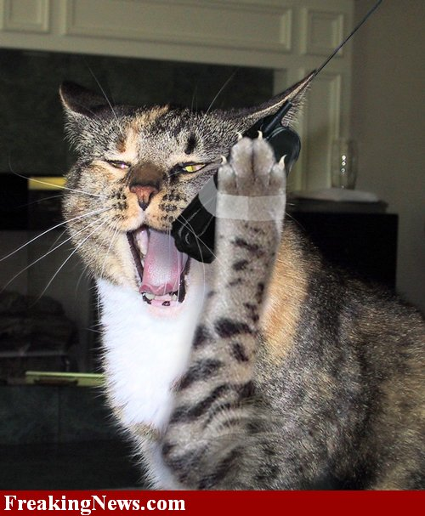
COMMUNICATIVE MANAGEMENT
“First objective in the successful management of a child is to establish communication.”
-McDonald & Avery(1978)
Communicative management is universally used in pediatric dentistry with both the cooperative & uncooperative child.
- Chambers (1976)

Slide 3
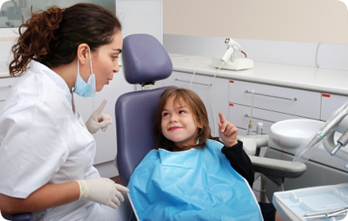
TYPES OF COMMUNICATION-
Verbal communication
Non-verbal (multisensory communication) is by:
- Body language
- Smiling
- Eye contact
- Expression of feelings without speaking
- By touching the child
- Giving him a pat
- Giving a hug
c) Both using verbal & nonverbal

Slide 4
How to communicate?
Communication should be comfortable & relaxed.
Language should contain words that express pleasantness, friendship & concern.
--Korch (1972)
Verbal communication for younger children, more than 3years of age. And non-verbal communication in less than 3years.
Tone of Voice should be constant & gentle.

Slide 5
Voice control should express empathy & firmness.
Content should be such that the child feels that we are his well wishers.
Patient should be addressed by his name
Compliment him about his appearance. Ask questions about his likes-dislikes.

Slide 6
USE OF EUPHEMISMS: these are substitute words.
Rubber dam Rain coat
Rubber dam clamp Tooth button
Rubber dam frame Coat rack
Sealant Tooth paint
Topical fluoride gel Cavity fighter
Air syringe Wind gun
Water syringe Water gun
Suction Vacuum cleaner
Alginate Pudding
Study models Statues
High speed Whistle
Low speed Motorcycle

Slide 7
Reframing:
Given by Benjamin Peretz (1999)
It is defined as taking a situation outside the frame that up to that moment contained the individual in different conditions, & visualize (reframe) it in a way acceptable to the person involved, so that the threatened situation can be abandoned.

Slide 8
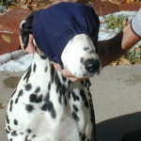
BEHAVIOR SHAPING
DESENSITIZATION:
Given by Joseph Wolpe,(1969)
Used to remove fears & anxiety in children with previous unpleasant dental experience or negative behavior.
Is accomplished by teaching the child a competing response such as relaxation & then introducing progressively more threatening stimuli.
E.g. Tell-Show-Do technique.

Slide 9
Tell-Show-Do Technique (TSD):
Given by Addleston (1959)
Tell & show every step & instrument & explain what is to be done.
From least fear promoting object or procedure to more fearful objects.
Indications- First visit
-Introducing new dental procedure
-Fearful child
Technique
Effective in children > 3years of age.

Slide 10
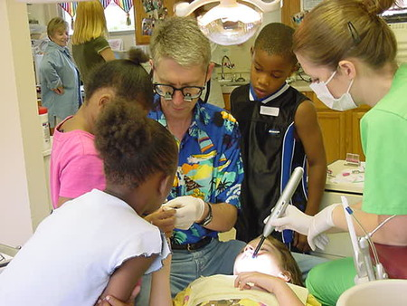
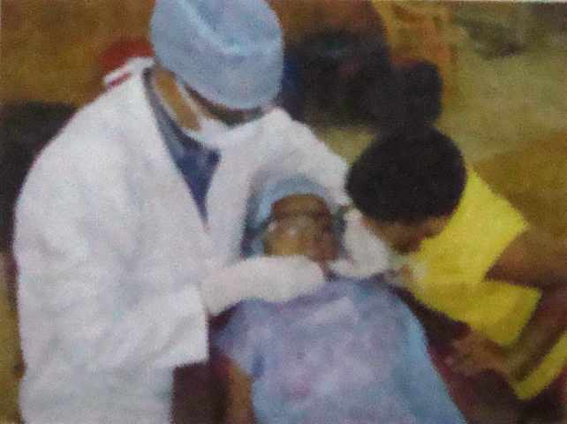
Modeling:
Given by Bandura,1969
Developed from Social- learning principle, procedure.
TECHNIQUE- allowing a patient to observe one or more individuals (models) who demonstrate a positive behavior in a situation.
Modelling can be done by-
Live models
Filmed models
Posters
Audiovisual aids

Slide 11
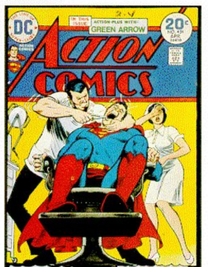
Contingency management:
Method of modifying the behavior of children is by
presentation or withdrawal of reinforcers.
Positive reinforcer- is one whose contingent presentation increases the frequency of behavior.
-- Given by Henry W. Fields(1984)
E.g. child rewarded for a good behavior

Slide 12
Negative reinforcer- whose contingent withdrawal increases the frequency of behavior . It is termination of aversive stimulus.
-- By Stokes & Kennedy (1980)
E.g. Withdrawal of the mother

Slide 13
Types of reinforcers-
Social- e.g. praise, positive facial expression, shaking hand, patting shoulder or back.
Material- e.g. toys, games, comics. Sweets are not given as reward.
Activity reinforcer - watching t.v.

Slide 14
BEHAVIOR MANAGEMENT
Audio analgesia:
Given by Gardner, Licklider(1959)
Also called as “White-noise”. Is a method of reducing pain by providing sound stimulus of such intensity that patient finds it difficult to attend to anything else.
E.g. auditory stimulus to reduce stress

Slide 15
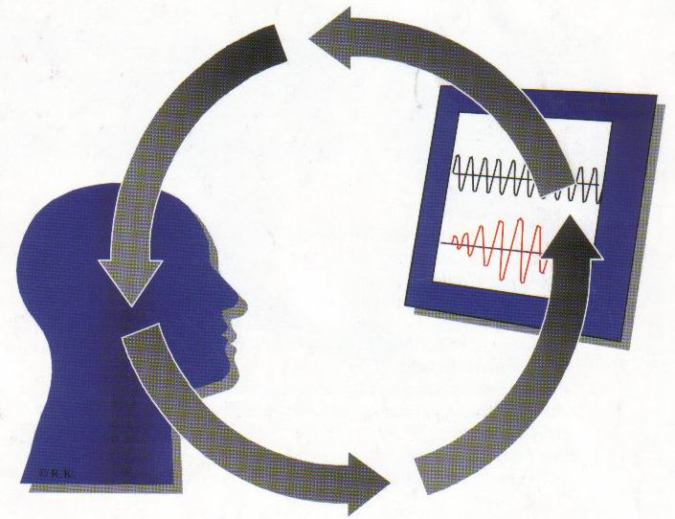
Biofeedback:
Given by Buonomono (1979)
Involves use of certain instruments to detect certain physiological processes associated with fear.
e.g. Blood pressure instrument, Electroencephalogram, to control anxiety & stress.

Slide 16
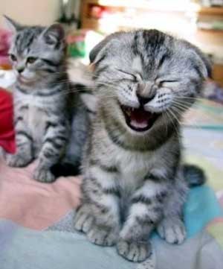
Humor :
Helps to elevate the mood of the child, which helps the child to relax. Functions-
Social- Forming a relationship
Emotional- Anxiety relief in child, parent.
Informative- Telling information in a non threatening way.
Cognitive- distraction from fearful stimuli.

Slide 17
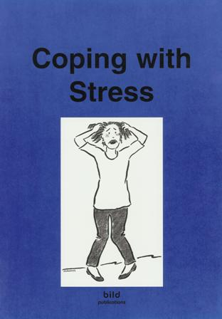
Coping:
Given by Lazaue (1980)
Defined as the cognitive & behavioral efforts made by an individual to master, tolerate or reduce stressful situations. Patients under stress prefer to draw comfort from the doctor/nurse.

Slide 18
2 types
Behavioral - physical or verbal activities
Cognitive – child tries to keep calm.
- Reality oriented thinking
- Cognitive reappraisal
- Emotion regulating cognitions. Given by Sandra L Curry (1988).

Slide 19
Signal system:
Given by Musslemann (1991).
As a part of coping, we ask the child to raise his hand, when it hurts during the procedure.
Usual coping mechanisms include: friendliness, support, reassurance.

Slide 20
5. Voice control:
Modification of intensity & pitch of one’s own voice in an attempt to dominate the interaction between the dentist & child.
Change in voice from gentle to firm for child’s attention & to remind that dentist is an authority figure.
Used with physical restraints & hand over mouth exercise (HOME). Given by Henry & Marilyn (1984)

Slide 21
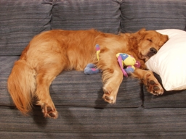
6. Relaxation:
To reduce stress .
Based on the principle of elimination of anxiety.
Involves a series of basic exercises which require the patient to practice at home for atleast 15 minutes.

Slide 22
Relaxation techniques for relief of anxiety/ stress in dental office—
Focusing – The attention on a small personal object which is of great interest to the patient.
Meditation- Sit or lie in a comfortable position with your eyes closed & breath deeply. Paying attention on your breathing & chest, abdomen movements.
Progressive muscle relaxation- Lie in comfortable position, with your arms at sides. Inhale &exhale deeply.
Clench your arms into fists & hold tightly for 15 seconds &then relax. Now tense each body part for 15 seconds & then relax it for 30 seconds separately.

Slide 23
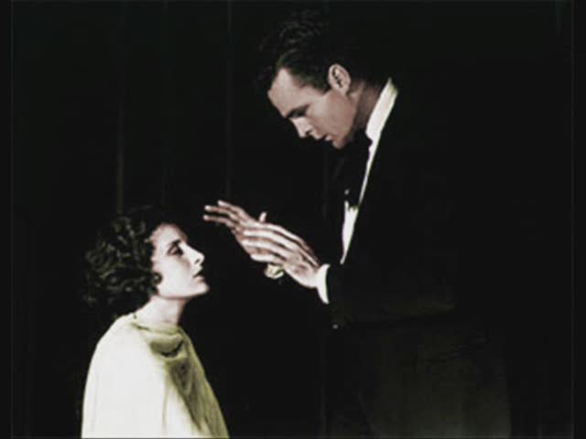
Hypnosis:
It is an altered state of consciousness characterized by a heightened suggestibility to produce desirable behavior & physiological changes.
One of the most effective non-pharmacological therapies used with children, to reduce anxiety & pain . Given by Romanson, (1981).
Hypnodontics, when used in dentistry. Given by Richardson (1980).

Slide 24
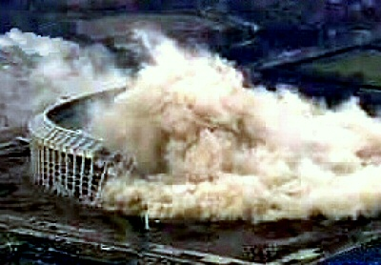
Implosion therapy:
Sudden flooding with a barrage of stimuli which have affected him adversely & the child has no other choice, but to face the stimuli until negative response disappears. Comprises HOME, voice control & physical restraints.

Slide 25
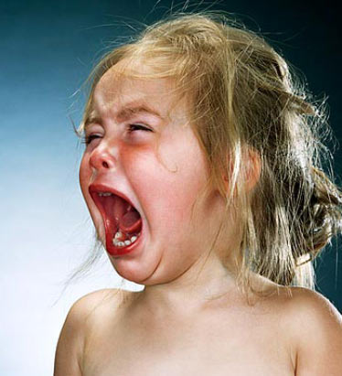
9. Aversive conditioning:
Children not responding to moderate behavior modification techniques are into Frankel’s definitive negative behavior.
Given by Patricia P Hagan (1984)
2 common methods-
A) HOME
B) Physical Restraints

Slide 26
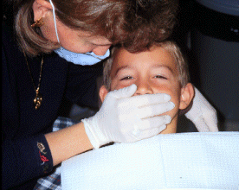
HOME (Hand-Over-Mouth Exercise):
Given by Evangeline Jordan (1920)
Purpose – To gain attention of the child so that communication can be achieved.
Indications-
- Healthy child who can understand, but shows hysterical behavior.
- 3 to 6 years old.
- Who can understand simple verbal commands

Slide 27
Contraindications-
- Under 3 years of age.
- Handicapped child/ frightened child / immature child.
Factors –
- Home technique not to used as a routine procedure
- Inform parents & have their consent
- Pediatric dentists should be aware of the changing laws that govern informed consent . Given by Hagan (1984), Nash (1988), Scott(1991)

Slide 28
HOMAR (Airway Restricted):
Advantage- Child will be quite unable to draw a breath for screaming
Disadvantage- Restricted airway. Child is also unable to breathe
Procedure should not be more than 15 seconds
Belanger , (1993) Airway restriction was a critical element & it should be avoided.

Slide 29
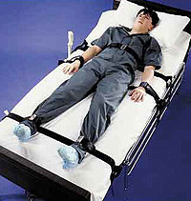
PHYSICAL RESTRAINTS:
Given by Kelly (1976)
Last resort for handling uncooperative patients
Hypermotive, stubborn children.
Child seated in the mother’s lap with one hand on wrists & other on forehead.
a) ACTIVE- by dentist, staff or parent
b) PASSIVE- by aid of restraining device.

Slide 30
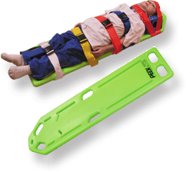
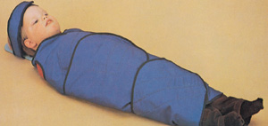
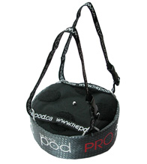
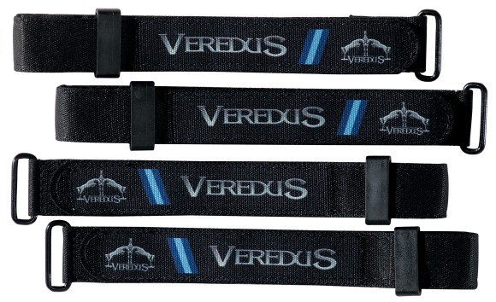
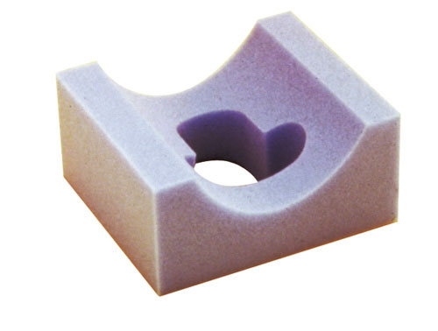
Types-
For body -Pedi wrap,
-Papoose board,
-Sheets,
-Beanbag with straps
-Towel & tapes
b) For extremities -Velcro straps
- Posey straps
c) For the head -Head positioner
-Forearm body support

Slide 31
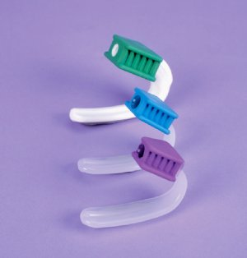
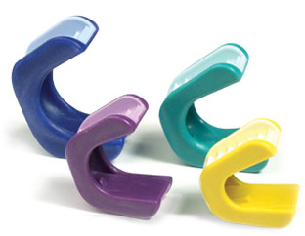
d) For mouth-
- Mouth/ bite blocks
- Banded tongue blades
- Mouth props at the time of local anesthesia

Slide 32
Take away home message
Frankel found that children in age group of 42-49 months are benefitted from mother presence in operatory.
Physical approach of behavior management are hand over mouth exercise and physical restrains.
Communication act as means for the dentist to know the child and his fears can be verbal and nonverbal type.

Slide 33
THANK YOU

